Slide 1



Bloom’s Taxonomy: Cognitive Domain
Marzieh Alidadi

Slide 2
Contents
Introduction
Thinking Skills
Cognitive Domain

Slide 3
Introduction
Thinking Skills
Cognitive Domain
Background
Domains
Improving the quality of how learners learn and teachers teach
Understanding the different levels at which you master knowledge
Planning lessons and measure students’ competence
Created by Benjamin Samuel Bloom at 1950s → Revised in 2001

Slide 4

Introduction
Thinking Skills
Cognitive Domain
Background
Domains

Slide 5
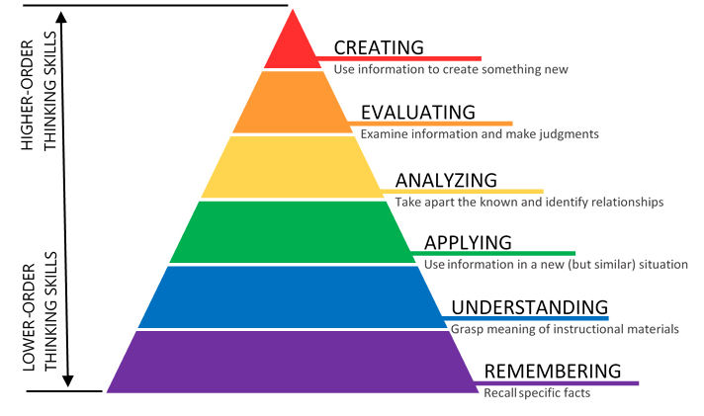
Introduction
Thinking Skills
Cognitive Domain
Cognitive Domain

Slide 6
Introduction
Thinking Skills
Cognitive Domain
Remember
Understand
Apply
Analyze
Evaluate
Create
The first order of thinking
Recalling relevant facts and figures from long-term memory
Associated action verbs: define, list, arrange, repeat

Slide 7
Introduction
Thinking Skills
Cognitive Domain
Remember
Understand
Apply
Analyze
Evaluate
Create
The second order of thinking
Comprehension and not just recall
Draw conclusions from information
Summarize information
Associated action verbs: explain, distinguish, paraphrase, summarize

Slide 8
Introduction
Thinking Skills
Cognitive Domain
Remember
Understand
Apply
Analyze
Evaluate
Create
The third order of thinking
Implement the facts and rules you have learned
Solve problems in new situations
Associated action verbs: calculate, solve, implement, demonstrate

Slide 9
Introduction
Thinking Skills
Cognitive Domain
Remember
Understand
Apply
Analyze
Evaluate
Create
The fourth order of thinking
Breaking information into its constituent parts
Interpreting how those parts relate to each other and to an overall structure
Associated action verbs: simplify, analyze, compare, research

Slide 10
Introduction
Thinking Skills
Cognitive Domain
Remember
Understand
Apply
Analyze
Evaluate
Create
The fifth order of thinking
Judging information based on criteria and standards
Associated action verbs: prove, convince, estimate, criticize

Slide 11
Introduction
Thinking Skills
Cognitive Domain
Remember
Understand
Apply
Analyze
Evaluate
Create
The final order of thinking
Combining previously assimilated elements in new ways to create something new
Associated action verbs: propose, develop, create, invent

Slide 12
Thanks for your attention! ☺

